Slide 1

Introduction to ML
Welcome to the Machine
Gene Olafsen

Slide 2
Origin of “Machine Learning”
The term “Machine Learning”, like many other popular words, is the result of a marketing initiative!
In 1959, while at IBM, Arthur Samuel, a pioneer in artificial intelligence and computer gaming, coined the term “Machine Learning”.
IBM used the “cool” term to differentiate its application capabilities and to attract both programming talent and new clients.
Btw: IBM tried this trick again in 2010 with the term “Cognitive Computing”.

Slide 3
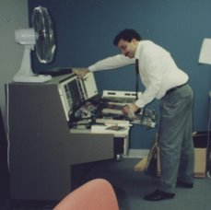
Early Objectives
What​
"The ability for the machine to learn without specific programming." -- A. Samuel '59 (IBM)​
Where​
OCR​ - Optical Character Recognition
Diagnostics – a 'self-learning' alternative to rule-based Expert Systems​
Notes:
The drivers for early machine learning initiatives.
OCR for use in tax collection, mail delivery.
Diagnostics for industry and the military.

Slide 4
Simply Put…
Machine Learning is about making machines perform better (given some performance measure) at a task by learning from data- instead of having to explicitly code more (or better) rules.

Slide 5
Software That Adapts
Traditional Code​
Write Program​
Write Rules​
Deploy​
Machine Learning​
Write Program​
Train Model​
Deploy​
Human Involvement
Can be Automated
Notes:
This slide does indicate that training and deploying a model doesn’t necessarily mean that the work is done.
Many models require ‘babysitting’

Slide 6
What is it Good For?
Machine Learning is great for:
Problems where the current solutions require many rules or much fine tuning.
Complex problems where traditional software approaches yield inadequate solutions.
Gaining insights about complex problems and large data sets.
Changing environments- machine learning systems can adapt to new data.
Notes:
I worked for a company whose SPAM solution required creating, editing, maintaining thousands of regex rules
You could probably write a program to recognize a stop sign or a traffic signal… but, custom code for each

Slide 7
Concrete ML Tasks and Techniques
Geron identifies some examples of Machine Learning tasks along with the techniques that can be used to tackle them.
Analyzing images of products on a production line to automatically classify them – This image classification, typically performed by convolutional neural networks (CNNs)
Detecting tumors in brain scans – This is semantic segmentation. Each pixel in the image is classified, as we want to determine the exact location and shape of tumors. CNNs
Automatically classifying news articles – This is natural language processing (NLP) which is somewhat of an umbrella term. More specifically text classification can be tackled using recurrent neural networks (RNNs), CNNs or Transformers.
Forecasting your company’s revenue next year, based on many performance metrics – This is a regression task (i.e. predicting values) that may be tackled using any regression model (Linear or Polynomial), a regression SVM, a regression Random Forest or even a neural network.
Notes:
Semantic Segmentation – input is an image, output is regions, structures
News article classification – suddenly there is not a 1-1 relationship between a problem and the ML solution

Slide 8
Concrete ML Tasks and Techniques (cont.)
An application that accepts voice commands - Speech recognition requires processing audio samples which are long and complex sequences, typically processed using RNNs, CNNs or Transformers
Segmenting clients based on their purchases so that you can design a different marketing strategy for each segment – This is clustering
Notes:
Recurrent
Convolution

Slide 9
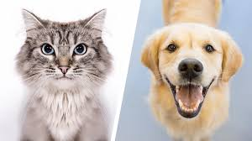
First ML Terms!
Feature: An input to the system
Terms in many cases which are substituted for feature
Attribute = Type of Data (Weight, Height, Age)
Predictor = Attribute + Value (I.e. 35 years old, 128,000 miles)
Label: An expected output
Cat Dog
Notes:
Time for the first ML terms!
Cat/dog labels
Features can be both numeric and categorical (Much of current machine learning is feature engineering)

Slide 10
Types of Machine Learning Systems
The broad categories of ML systems include:
Whether or not they are trained with human supervision. (four major categories)
Supervised
Unsupervised
Semisupervised
Reinforcement Learning
Whether or not they can learn incrementally on the fly
Online
Batch (or offline)
Whether they work by simply new data points to know data points OR instead detect patterns in the training data and build a predictive model (much like scientists do)
Instance-based
Model-based
Note: The heading color of each of the following slides corresponds to the ML category above.
Notes:
There are many ways to classify ML systems, this breaks them down into 3 large categories and further subdivides

Slide 11
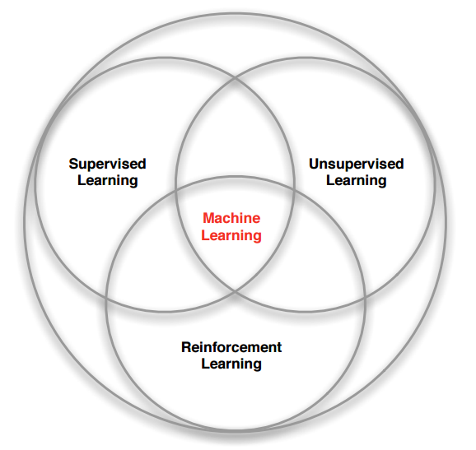
ML Overlap
Notes:
I will ask Scott to speak to this slide

Slide 12
Supervised Learning
The training set (data) you feed to the algorithm includes the desired outcome, called labels.
Useful for:
Identifying a class (Classification)
A spam filter is a perfect example.
Predicting a value (Regression)
Training Data
New Data Instance
Value
Algorithm predicts the value
Feature 1
Notes:
Spam filters are interesting because in many systems, users are active in identifying ‘new’ spam instances.

Slide 13
Supervised Learning Algorithms
Some of the most important supervised learning algorithms include:
K-Nearest Neighbors
Linear Regression
Logistic Regression
Support Vector Machines (SVMs)
Decision Trees and Random Forests
Neural Networks (though some can be unsupervised and semisupervised)

Slide 14
Unsupervised Learning
Utilizes unlabeled training data sets.
The system tries to learn without a teacher.
The data set consists of features (inputs) without the anticipated answers (labels).
Commonly used to visualize large complex data sets. There are algorithms that can plot the data in 2D and 3D to help (humans) identify patterns.
The following slide contains visualizations that result from unsupervised learning training.

Slide 15
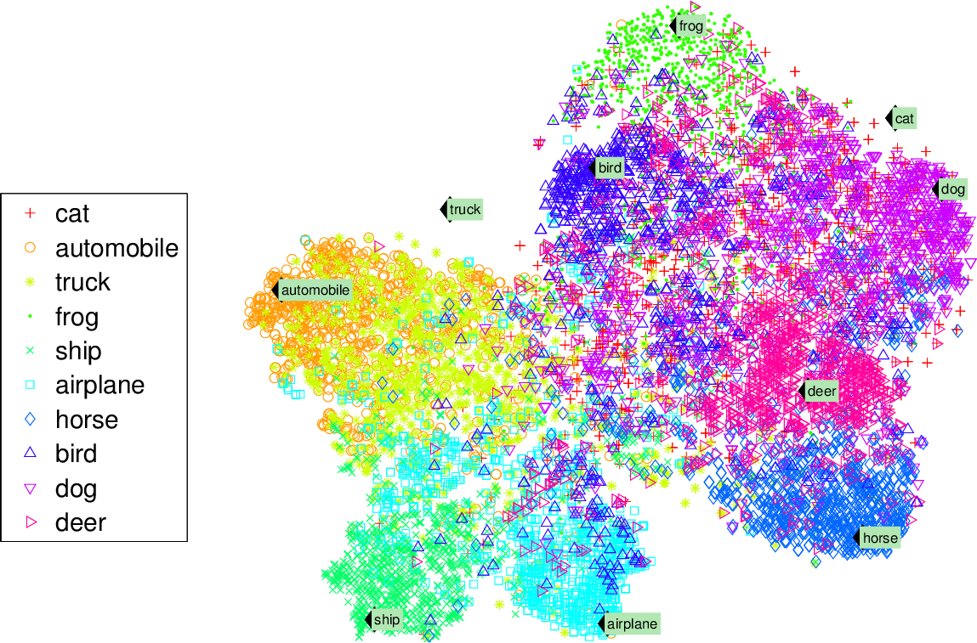
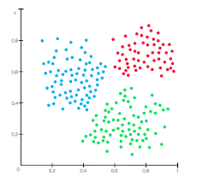
Clustering
A simple clustering of data with very identifiable boundaries is shown below.
Notice in the clustering to the right how the horse and deer are close together, while the bird category is further away.

Slide 16
Unsupervised Learning Algorithms
Clustering
K-Means
DBSCAN
Hierarchical Cluster Analysis (HCA)
Anomaly and novelty detection
On-class SVM
Isolation Forest
Visualization and dimensionality reduction
Principal Component Analysis (PCA)
Kernel PCA
Locally Linear Embedding (LLE)
T-Distributed Stochastic Neighbor Embedding (t-SNE)
Association rule learning
Apriori
Eclat
Notes:
So there are a number of unsupervised algos… each one can explored in a separate presentation.
While it seems overwhelming, once you spend some time with ML, the high-level ‘concept’ behind these algorithms becomes clearer.

Slide 17
Anomaly Detection
Another common use of unsupervised learning is anomaly detection.
The system is shown mostly ‘normal’ instances during training. When the system is presented with a new instance it should be able to tell whether it looks like a normal one or whether it is likely and anomaly.
Anomaly detection examples include identifying credit card fraud or catching manufacturing defects.
Training Data
New Data Instance
Feature 2
Feature 1

Slide 18
Semisupervised Learning
Labeling data is a time-consuming (and costly) undertaking.
You may often have plenty of unlabeled data, and a smaller amount of labeled data.
Semisupervised learning is a form of machine learning that can accept partially labeled data.
Most semisupervised learning algorithms are combinations of unsupervised and supervised algorithms.
If you think of Google Photos- you label a family member once, and the system identifies that person in your other photos.

Slide 19
Semisupervised Learning Example
This semisupervised learning example has two classes, thunderbolts and clouds.
The unlabeled circles help classify a new instance, designated by a cross.
Unlabeled Data
New Data Instance

Slide 20
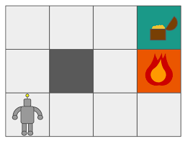
Reinforcement Learning
A process by which the machine learning system strives to maximize reward.
Reinforced learning is very different from systems typically used by the other learning strategies.
The learning system, called an agent, can observe the environment, select and perform actions, and get rewards in return for those actions.

Slide 21
Reinforcement Learning Examples
Winning at Go (AlphaGo)
Robot balancing (Segway, inverted pendulum)
Atari video game mastery
Crawler robot!

Slide 22
Batch and Online Learning
Another way that Machine Learning can be categorized is whether or not the system can learn incrementally from a stream of new data.

Slide 23
Batch (Offline) Learning
In batch learning, the system is incapable of learning incrementally, it must be trained using all the available data.
Pros:
Offer 'laboratory-like' control over the training
If your edge-device is resourced constrained, this may be your only choice. Training may happen in the cloud and the model is downloaded.
Cons:
To update the existing system must be stopped and restarted with new 'knowledge’
Training on a full set of data requires a lot of computing resources (CPU, memory, disk, disk I/O, network I/O, etc.)

Slide 24
Online Learning
Online learning trains the system incrementally, feeding data instances either individually or in small groups known as mini-batches.
Pros:
Each learning step is fast and cheap.
Works on datasets that are too large to load at once. (this is known as out-of-core learning)
Cons:
Bad data will degrade system outputs (E.g. Faulty sensors)
Perhaps employ an anomaly detection system to scrub bad data (as described earlier).

Slide 25
Online Learning and Learning Rate
Online learning is great for systems that receive a continuous flow of data and need to adapt to change quickly and without human intervention.
An important parameter of online learning systems is one that controls how quickly they should adapt: this is called the learning rate.
Learning rate is set high, your system will adapt to new data quickly, but will also tend to forget old data.
Learning rate is set low, your system will learn slowly, but it may be less sensitive to noise.

Slide 26
Machine ‘Unlearning’
Quick aside.
There are instances where a model is required to forget something.
General Provision
"Right to be forgotten" mandates that companies take “reasonable steps” to achieve “the erasure of personal data concerning” an individual
Legislation
European Union: General Data Protection Regulation (GDPR) ​
US: California Consumer Privacy Act ​
Canada: PIPEDA privacy legislation
Paper and presentation on Machine Unlearning is on our GitHub.

Slide 27
Instance or Model-based Learning
A final way that Machine Learning systems can be categorized is how they generalize.
Given many training examples, the system needs to be able to make good predictions for (generalize to) examples it has never seen before.

Slide 28
Instance-based Learning
Utilizes a measure-of-similarity to compare learned attributes against new instances
A family of learning algorithms that, instead of performing explicit generalization, compares new problem instances with instances seen in training.
Consider the illustration:
New Data Instance

Slide 29
Similarity Measurement
Similarity measure is the measure of how much alike two data objects are. If this distance is small, there will be the high degree of similarity and if this distance is large, there will be the low degree of similarity.
Similarity is measured in a range between 0 and 1.
There are several common methods to measure similarity.
Euclidean Distance
Manhattan Distance
Minkowski Distance
Cosine Similarity
Jaccard Similarity
Let’s look at a couple of these methods…

Slide 30
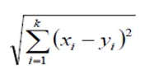
Euclidean Distance
Euclidean distance is also known as simply distance.
When data is dense or continuous, this is the best proximity measure.

Slide 31
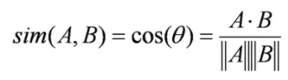
Euclidean Distance
Cosine similarity metric finds the normalized dot product of two attributes.
Cosine similarity is very efficient to evaluate and is especially popular for sparse vectors.

Slide 32
Model-based Learning
Another way to generalize from a set of examples is to build a model of the training set examples and then use that model to make predictions.
The developer needs to select the model
Linear (Line)
Higher degree polynomial (Curve)
New Data Instance

Slide 33
Model-based Sample
Consider this data as a starting point from which we would like to make predictions about data which we have not seen.
Training Data

Slide 34
Model-based Sample Training
There are an infinite number of lines that can be drawn across the dataset... The Linear Regression algorithm finds the parameters that make the linear model best fit your data. This is called training your model.
Training Data

Slide 35
Model-based Sample Cost Function
You need to specify a performance measure to know where to draw the line for your model to perform best.
For Linear Regression problems, typically you define a cost function that measures the distance between the linear model’s predictions and the training data instance. The objective is to minimize this distance. The cost function measures how bad the model performs.
It is also possible to define a function which determines how well the model performs- this is called a utility function.
Notes:
Is there a time when a utility function is better than a cost function?
Utility function is used to derive demand for goods or products. A preference for goods or services.

Slide 36
Machine Learning Data Challenges
Lack of training data
Poor data quality
Non-representative data
Irrelevant features
Overfit data
Underfit data

Slide 37
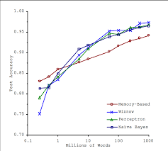
Lack of Training Data
Humans can learn to recognize something they have never seen before with a single image. Even toddlers can learn to recognize something new with a handful of encounters.
Machine learning , for even very simple problems, typically needs thousands of examples. For complex problems, such as image or speech recognition, may need millions of examples.
“The Unreasonable Effectiveness of Data” (https://homl.info/7), published in 2009 by Peter Norvid and an earlier paper in 2001 by Microsoft researchers Michele Banko and Eric Brill (https://homl.info/6) state that given enough data, very different ML algorithms, include fairly simple ones, performed almost identically.

Slide 38
Poor Data Quality
Data which is full of errors, noise and outliers will make it more difficult for your system to detect underlying patterns. Your system is less likely to perform well.
Data scientists spend a significant portion of their time cleaning up data. Here are some techniques they might use:
For data instances that are clearly outliers- you may either fix the value by hand or remove the data entirely.
If instances are missing features, you must decide whether to ignore the attribute entirely, ignore the instances, provide default values for the missing attribute (median value), etc.
Notes:
Crawler slipping back.

Slide 39
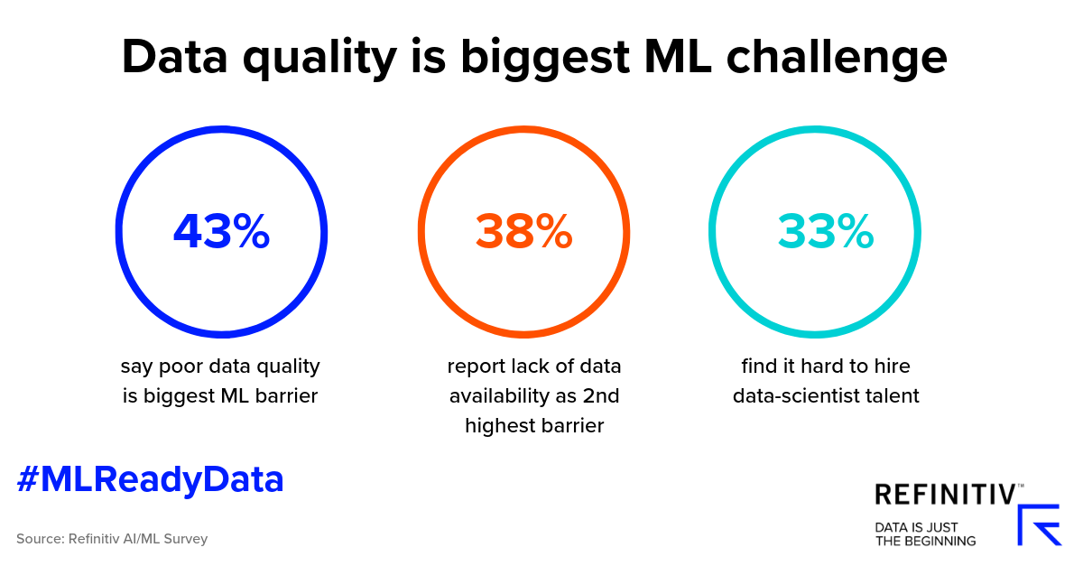
Talent Challenge
In addition to having clean data- acquiring the talent to clean the data is proving to be a challenge.

Slide 40
Non-representative Data
In order to generalize well, it is important that your training data is representative of the new cases (instances) that you want your system to generalize to.
Note: This is true of both instance-based learning or model-based learning systems.
Let’s look at an example…

Slide 41
GDP vs Life Satisfaction
Training Data
New Data Instance
Life Satisfaction
Brazil, Mexico, Chile
Norway, Switzerland, Luxemburg
GDP per capita

Slide 42
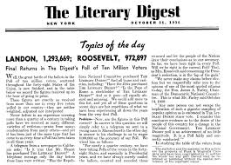
Sampling Noise and Bias
Sampling noise is often present if your training data sample is too small. This is nonrepresentative data as a result of chance.
Sampling bias can be present in both small and very large training data. This nonrepresentative data can be attributed to a sampling method that is flawed.
Literary Digest sent polling questions to those with telephones, members of clubs and magazine subscribers. These people tended to be wealthier.
Less than 25% of those polled responded. These people may be less interested in politics or the Literary Digest magazine. This is a special case of sampling bias- nonresponse bias.

Slide 43
Irrelevant Features
If your training data contains too many irrelevant features and not enough relevant ones, your system will have trouble learning. Think: Garbage in, garbage out!
It is critical to select those features which can train your model correctly. This process is known as feature engineering, and involves the following steps:
Feature Selection – selecting the most useful features
Feature Extraction – combining features to produce a more useful one. This is the process known as dimensionality reduction.
Create new features by gathering new data.

Slide 44
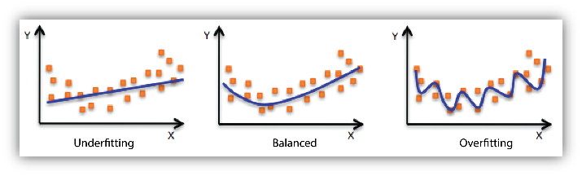
Overfit the Training Data
Overfit is a term used to describe machine learning models that perform well on training data but fail to perform well when presented with new data instances.
Such models are said to not generalize well.
Overfitting happens when the model is too complex relative to the amount (and noisiness) of the training data that you provide.
Notes:
This model will be REALLY good at predicting values. BUT only for this data! Chances are that this model will not perform well for other data.

Slide 45
Possible Overfit Solutions
There are techniques that you can employ to reduce overfitting.
Reduce the number of attributes in your training data.
Simplify the model by selecting one with fewer parameters (a linear model as opposed to a higher-degree polynomial model)
Acquire more training data.
Reduce the noise in the training data. As covered in the Poor Data Quality slide- remove or correct bad data instances and remove outliers.
Purposefully adding noise to inputs or using dropouts can also help prevent overfitting.
Finally, the model itself can be constrained. The process of constraining a model to make it simpler and reduce the risk of overfitting is called regularization. (Regularization is an important machine learning concept and deserves its own slide deck.)
Notes:
Companies like DataRobot are automating this model selection and tuning process

Slide 46
Underfit the Training Data
Underfitting is the opposite of overfitting and it occurs when your model is too simple to learn the structure of the training data.
Notes:
The underfit model does not contain the ‘nuance’ of the curve in the data.

Slide 47
Possible Underfit Solutions
There are techniques that you can employ to reduce underfitting.
Use feature engineering to provide better features to the learning algorithm.
Select a more powerful model. (Typically one with more parameters)
Reduce the constraints on the model. (For models that contain a regularization hyperparameter, this value can be reduced.)

Slide 48
No Free Lunch Theorem
David Wolpert wrote a famous paper in 1996 (https://homl.info/8), demonstrating that if you make absolutely no assumptions about the data, then there is no reason to prefer one model over any other.
This is known as the No Free Lunch (NFL) Theorem.
For some datasets the best model is a linear model, for other datasets it is a neural network. There is no model that is a priori guaranteed to work better.
The only way to know for sure which model is best is to evaluate them all- and since this is not possible, you need to make some reasonable assumptions about your data and evaluate a few reasonable models.
Notes:
Kind of depressing?
Machine learning requires thinking like scientist in a lab.

Slide 49
Summary
We have learned that Machine Learning is about making machines get better at a task by learning from data- as opposed to writing code.
We have identified and explored three broad categories of Machine Learning.
We have seen how important data is to the performance of Machine Learning models.

